Slide 1
Data Flow Diagram (DFD) Basics

Slide 2
DFD (Data Flow Diagram)
Developed in the early 70s, and still useful
Simple: easy to learn, sketch
Threats often follow data
Abstracts programs into:
Processes: your code
Data stores: files, databases, shared memory
Data flows: connect processes to other elements
External entities: everything but your code & data Includes people & cloud software
Trust boundaries (now made explicit)

Slide 3
Data Flow Diagram (DFD): Symbols
Process
External Entity / Interactor
Data flow
Data store
Trust boundary

Slide 4
External Entity
A producer or consumer of data
Examples: a person, a device, a sensor
Another example: computer-based system
Data must always originate somewhere and must always be sent to something

Slide 5
Process
A data transformer (changes input
to output)
Examples: compute taxes, determine area, format report, display graph
Data must always be processed in some
way to achieve system function

Slide 6
Data Flow
Data flows through a system, beginning
as input and transformed into output.
base
compute
triangle
area
area
height

Slide 7
Data Stores
Data is often stored for later use.
sensor #
sensor #, type,
location, age
look-up
sensor
data
report required
type,
location, age
sensor number
sensor data

Slide 8
DFD Elements: Examples
External Entity | People, other systems
Process | DLLS, Components, Services, Web Services
Data Flow | Function call, Network traffic, Remote procedure call
Data Store | Database, file, registry, shared memory, queue
Trust Boundary | Process boundary, file system, system boundary

Slide 9
DFD Rules and Tips
Each process should have at least one input and an output.
Each data store should have at least one data flow in and one data flow out.
Data stored in a system must go through a process.
All processes in a DFD go to another process or a data store.

Slide 10
DFD levels and layers:
A data flow diagram can dive into progressively more detail by using levels and layers, zeroing in on a particular piece.
DFD levels are numbered 0, 1 or 2, and occasionally go to even Level 3 or beyond.
Examples :
https://www.geeksforgeeks.org/what-is-dfddata-flow-diagram/
https://www.geeksforgeeks.org/levels-in-data-flow-diagrams-dfd/

Slide 11
DFD 0
DFD Level 0 is also called a Context Diagram. It’s a basic overview of the whole system or process being analyzed or modeled.
Shows the system as a single high-level process, with its relationship to external entities.

Slide 12
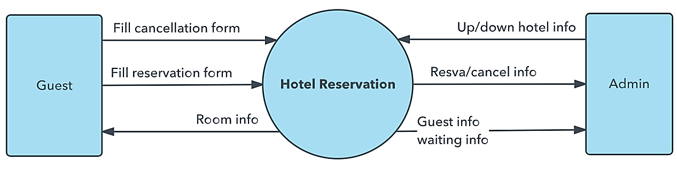
DFD 0

Slide 13
DFD-1
DFD Level 1 provides a more detailed breakout of pieces of the Context Level Diagram.
You will highlight the main functions carried out by the system, as you break down the high-level process of the Context Diagram into its sub-processes.

Slide 14
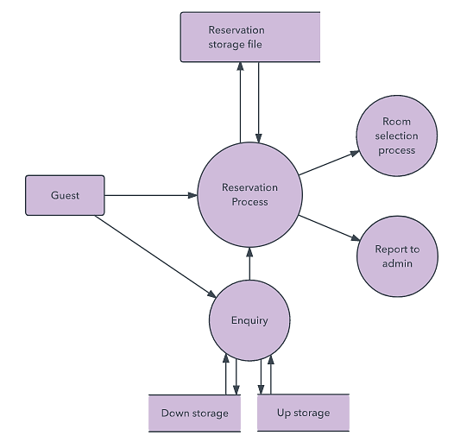
DFD-1

Slide 15
DFD-2
DFD Level 2 then goes one step deeper into parts of Level 1.
It may require more text to reach the necessary level of detail about the system’s functioning.

Slide 16
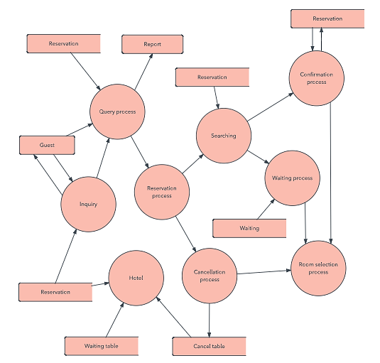
DFD-2

Slide 17
DFD 3, 4
Progression to Levels 3, 4 and beyond is possible, but going beyond Level 3 is uncommon.
Doing so can create complexity that makes it difficult to communicate, compare or model effectively.

